Slide 1



RETAIL SALES ANALYICS & CUSTOMER SEGMENTATION
TEAM MEMBERS:
V.JYOTHSNA(24BCD7240)
K.LIKHITA(24BCD7226)

Slide 2
PROBLEM STATEMENT
Retail businesses generate large volumes of transaction data, but:
Poor customer understanding
Generic marketing strategies
No churn identification
No customer segmentation
Problem:
How can we transform raw retail data into meaningful insights and actionable business strategies?

Slide 3
DATASET
We used an E-commerce retail dataset containing transactional data.
Key Features:
Customer ID
Invoice Date
Product
Quantity & Price
Dataset contains thousands of real-world transactions

Slide 4
DATA PREPROCESSING
Removed missing values
Filtered invalid transactions
Removed duplicates
Created Total Price
Ensured clean and reliable data

Slide 5

MODEL & WHY
Title: Models Used and Justification
1. RFM Analysis
Recency → Last purchase
Frequency → Purchase count
Monetary → Total spending
Why?
To identify valuable customers based on behavior.

Slide 6
MODEL & WHY
2. K-Means Clustering
Groups customers into segments
Why?
No labeled data required
Helps in customer segmentation
Simple and efficient
3.RANDOM FOREST (CHURN PREDICTION)
Predicts whether a customer will churn or not
Why Random Forest?
High accuracy
Handles complex patterns
Works well with tabular data

Slide 7
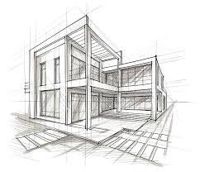
SYSTEM ARCHITECTURE
Data Collection
Data Cleaning
Feature Engineering (RFM)
Customer Segmentation (K-Means)
Churn Prediction (Random Forest)
Visualization & Insights

Slide 8
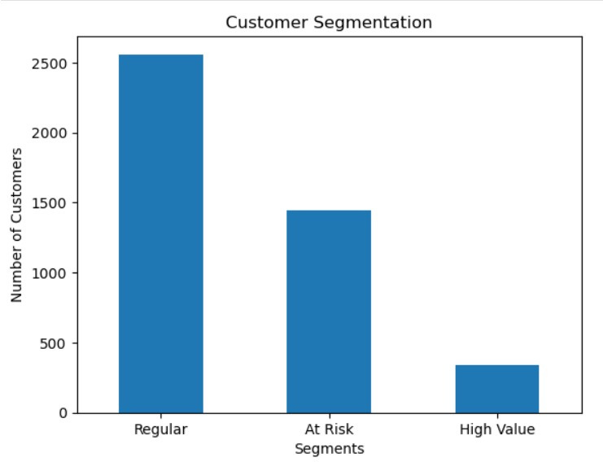
CUSTOMER SEGMENTATION
Customers grouped into:
High Value
Regular
At Risk
Insight:
High-value customers contribute major revenue
Helps in targeted marketing

Slide 9
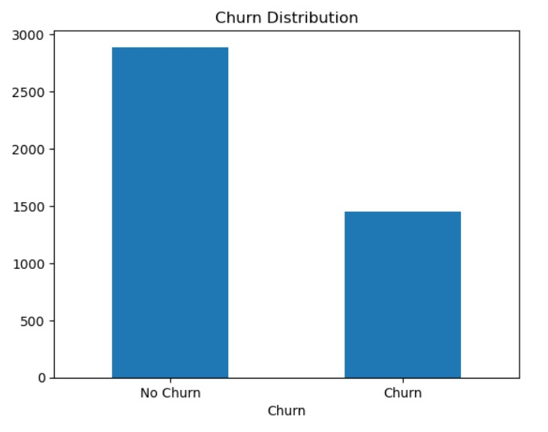
CHURN ANALYSIS
Identifies customers likely to leave
Insight:
Significant number of customers are at risk
Helps in retention strategies

Slide 10
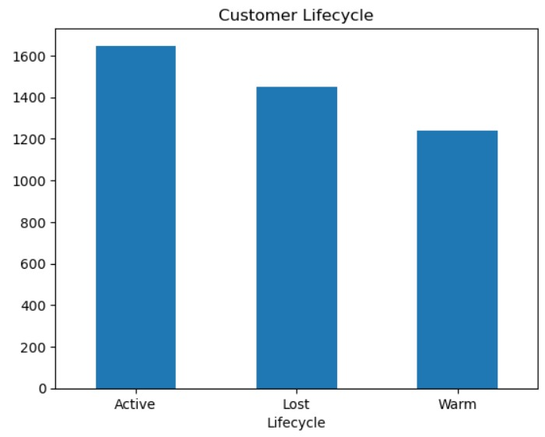
CUSTOMER LIFECYCLE
Customers classified as:
Active
Warm
Lost
Insight:
Helps track engagement levels

Slide 11
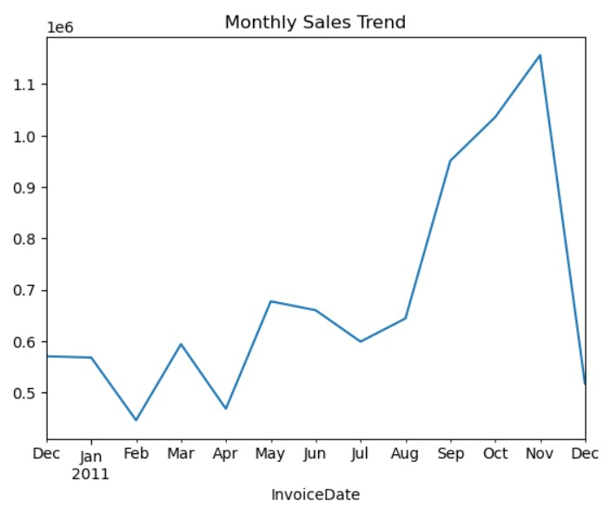
SALES TREND
Shows revenue variation over time
Insight:
Helps identify business growth patterns

Slide 12
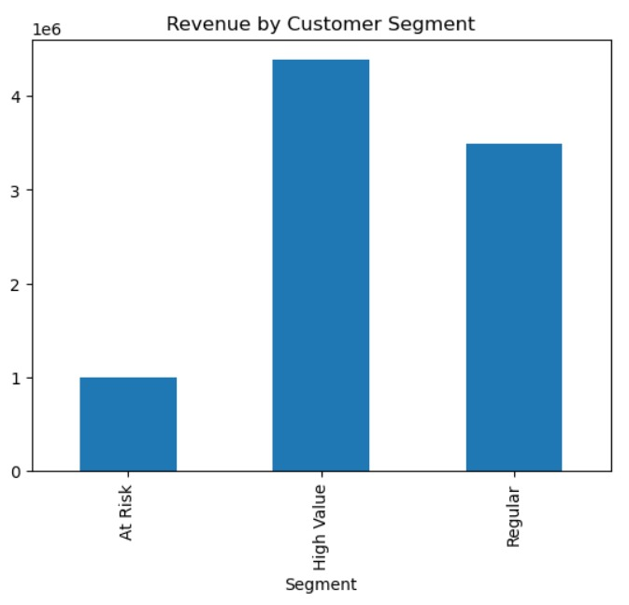
REVENUE BY SEGMENT
Revenue distribution across segments
Insight:
High-value customers generate most revenue

Slide 13
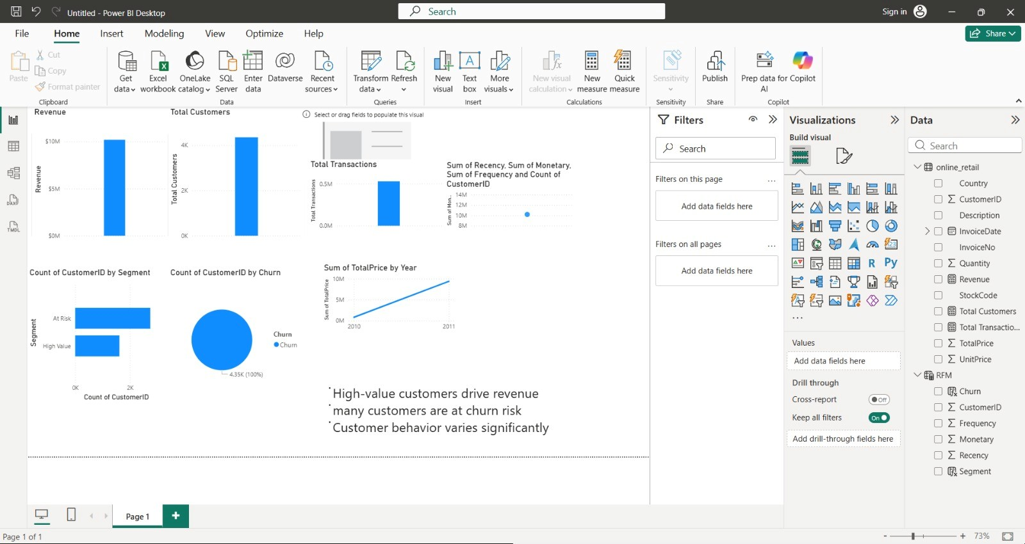
POWER BI DASHBOARD

Slide 14
RESULT
Customers segmented into different groups:
High Value
Regular
At Risk
Churn prediction achieved good accuracy
Identified:
High-value customers contributing major revenue
Customers likely to churn
Customer lifecycle stages
Key Result:
The system successfully converts raw data into actionable insights.

Slide 15
BUSINESS INSIGHTS
High-value customers drive majority revenue
Many customers are at risk of churn
Customer behavior varies significantly
Personalized strategies improve retention

Slide 16
COMPARISION
Traditional System
No segmentation
Generic marketing
No churn prediction
Manual analysis
Our System
Customer segmentation using K-Means
Personalized strategies
ML-based churn prediction
Automated data-driven insights

Slide 17
CONCLUSION
Final Outcome:
The system transforms raw retail data into actionable business strategies that improve customer retention and maximize revenue.

Slide 18

FUTURE SCOPE
Real-time dashboard using Streamlit / Power BI
Recommendation system for products
Integration with business CRM systems
Seasonal and festival-based sales prediction

Slide 19
THANK YOU

